Slide 1
Indentation in Eclipse

Slide 2
Make your code look good
Java code is a series of blocks.
Well organized blocks are important to understand source code.
Use a tab key to do indentation
class MyClass{
int myVariable =1;
public void myMethod(){
int mySecond variable = 2;
for(int i=0; i<2;i++){
System.out.println("My line");
}
}
}
class MyClass{
int myVariable =1;
public void myMethod() {
int mySecond variable = 2;
for(int i=0; i<2;i++) {
System.out.println("My line");
} // End of for
} // end of myMethod
} // end of MyClass

Slide 3
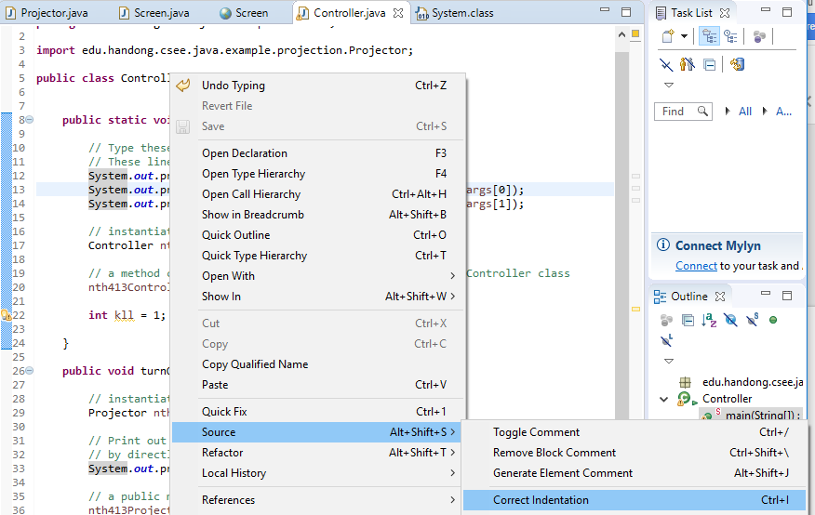
Correct Indentation in Eclipse
Pop-up menu on the editor → Source → Correct Indentation
Or Ctrl+I

